Slide 1
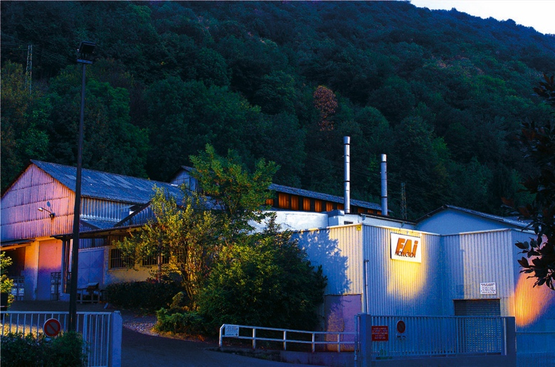


Confidential

Slide 2


IFAPA – International Ferroalloys Conference 2018
Who we are:
Engineering and commercial company in Switzerland
Manufacturing plant in France
Our brand for your satisfaction
Confidential

Slide 3
IFAPA – International Ferroalloys Conference 2018
How and why copper quality and design are essential to furnace reliability and profitability
2) COMETVA solutions
Confidential

Slide 4
IFAPA – International Ferroalloys Conference 2018
How to optimize, for one part, furnace profitability:
No furnace stoppages for maintenance:
  - Stabilized process and then better performance
  - Higher liquid production
Electrical consumption :
  - Better electrical conductivity owing to high copper purity => decreasing contacts electrical resistance
  - Better electrical power efficiency
More safety :
  - Reduce to near zero the risk of explosion due to water leakages
  - Less time spent into and around furnaces by maintenance employees.
Confidential

Slide 5
IFAPA – International Ferroalloys Conference 2018
How to optimize furnace reliability:
Copper quality : metallurgical ISOTROPIC structure of 99.9 %
copper and maxi electrical conductivity : 100 % IACS
- To get high thermal and electrical conductivity
- To withstand to high thermal stress
Tailor-made design for each furnace and each Ferroalloy
- To increase components lifetime
- Optimal ratio between copper mass implemented and
cooling layout.
Cooling copper parts : optimization
- Less water quantity used for a much better behaviour in
operation
- To respect process constraints as Soderberg baking zone level
Confidential

Slide 6
IFAPA – International Ferroalloys Conference 2018
Copper Quality:
Existing copper technologies:
  Casted copper and alloys
  Laminated or hot rolled copper
  Genuine forged copper
Confidential

Slide 7
IFAPA – International Ferroalloys Conference 2018
Copper Quality:
Casted copper:
- Cooling circuit often is performed with metal copper casted
around a steel or copper pipe
Advantages:
- All shapes can be casted
Disadvantages:
- Impossible to get a nice bonding between cooling pipe and
casted copper (thermal barrier)
- Lot of porosity inside the casted piece
    - Poor behaviour at high temperature
Poor thermal and electrical conductivity and very low withstand to thermal stress
Confidential

Slide 8
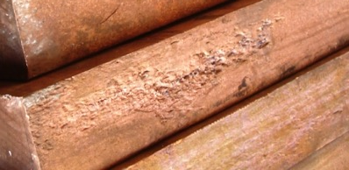
IFAPA – International Ferroalloys Conference 2018
Copper Quality:
Laminated copper:
- Copper slab casted then squeezed in one direction only
Advantages:
- Cooling line drilled
- Less porosity on surface only
Disadvantages:
- Limited slab thickness (180 mm max) rate
- Grain structure difference between outer and inner section.
(inner similar to a casted grain structure).
This heterogeneous structure leading to the appearance of
cracks quickly.
Confidential

Slide 9
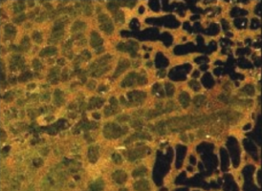
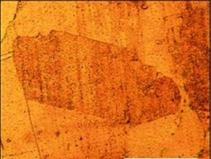
IFAPA – International Ferroalloys Conference 2018
Copper Quality:
Laminated copper:
Structure comparison:
Heterogeneous structure
Isotropic structure
Smaller grain structure with heterogeneous structure : favours cracks
Much more grains for same copper volume of parts
The total length of the grain boundary is longer with a small grain
structure then with isotropic structure which lead to lot of
oxidation
Confidential

Slide 10
IFAPA – International Ferroalloys Conference 2018
Copper Quality:
Laminated copper:
- Copper slab casted then squeezed in one direction only
Advantages:
- Cooling line drilled
- Less porosity on surface only
Disadvantages:
- Limited slab thickness (180 mm max) rate currying insufficient
- Grain structure difference between outer and inner section.
(inner similar to a casted grain structure).
This heterogeneous structure leading to the appearance of
cracks quickly.
- This heterogeneous grain structure causes higher oxidation
quantity (difficulty to get good weldings)
For Ferroalloys furnaces application, there is insufficiency of
thermal and electrical conductivity
Confidential

Slide 11
IFAPA – International Ferroalloys Conference 2018
Copper Quality:
Genuine COFOR® forged copper:
- Copper casted in our premises then forged according our own
knowhow
Advantages:
- Thanks to isotropic structure excellent thermal and electrical
conductivities
- No porosity and thickness up to more 400 mm
- Specific grain size allowing copper expansion during
thermal stress
Apparent Disadvantages:
- After a first accounting analysis our prices look higher, but if we consider our guarantee on life span and the impact on furnace lifetime and performances we are really the cheapest.
The most advanced technology for your furnace profitability and reliability
Confidential

Slide 12
IFAPA – International Ferroalloys Conference 2018
Examples of usual defaults with bad copper quality
Confidential

Slide 13
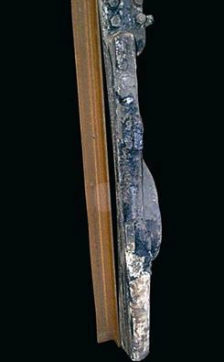
IFAPA – International Ferroalloys Conference 2018
Contact shoes deformation
By lack of stiffness strength: pieces distorted.
impossible pieces shape change, only if :
nice compromise between
granular isotropy and
optimized cooling line
design.
Deformations lead to arcing and pieces destructions
Confidential

Slide 14
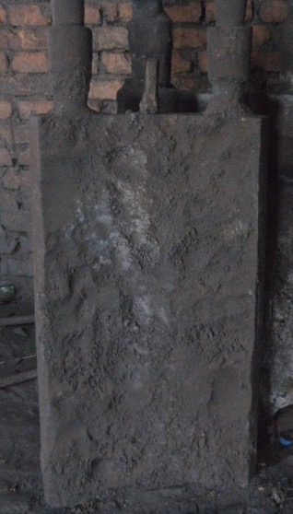
IFAPA – International Ferroalloys Conference 2018
Contact shoes arcing damage
Electrical arcing damage due to a bad piece design and a bad cooling design.
Furnace stoppage assured .
Confidential

Slide 15
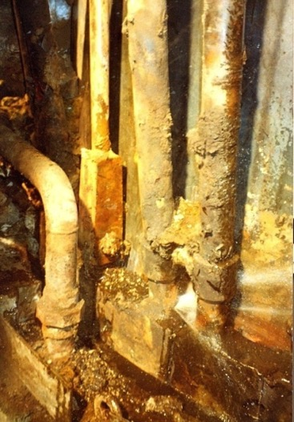
IFAPA – International Ferroalloys Conference 2018
Contact shoes sleeves leakages
Due to :
a bad design
a bad copper quality
a bad welding due to poorly deoxidized
important leakages, risk of explosion leading to furnace stoppage and so a loss of production
Confidential

Slide 16
IFAPA – International Ferroalloys Conference 2018
COMETVA solutions
Confidential

Slide 17
IFAPA – International Ferroalloys Conference 2018
COMETVA Solutions:
Tailor made design with light, medium and heavy solutions:
- To match to each kind of ferroalloys produced
- To match with the required guarantee time (from 2 years up to
6 years)
- To take into account overall dimension of furnaces and
furnaces power
- Usual life span today more than 10 years (93 furnaces supplied worldwide at this hour)
- Thermal simulation and forge softwares are used to define the best cooling circuit and the proper mass to implement well dedicated to each application. All this,
considering existing process parameters for furnaces users.
Confidential

Slide 18
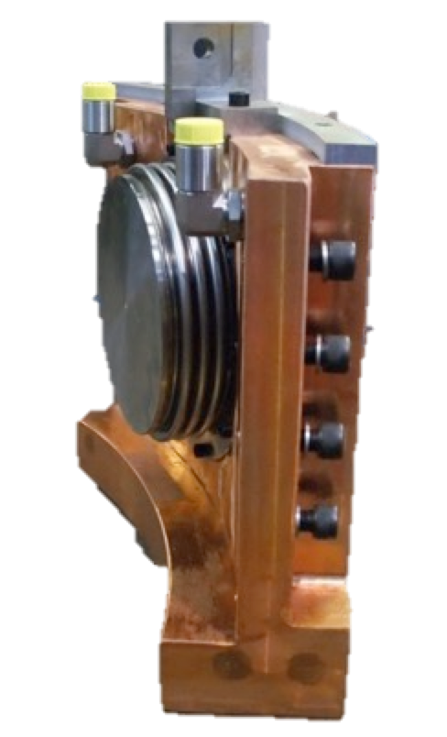
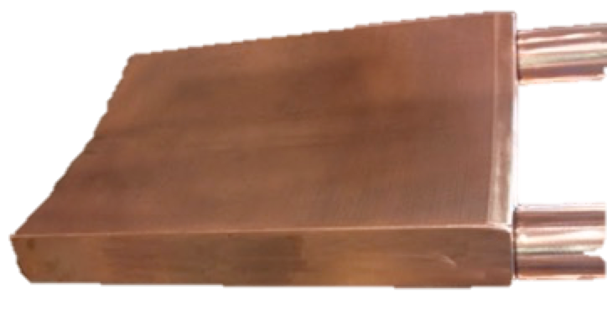
IFAPA – International Ferroalloys Conference 2018
COMETVA Solutions:
Tailor made design with light solution:
- Example of weight for 1 400 mm electrode diameter:
475 Kg
262 Kg
Confidential

Slide 19
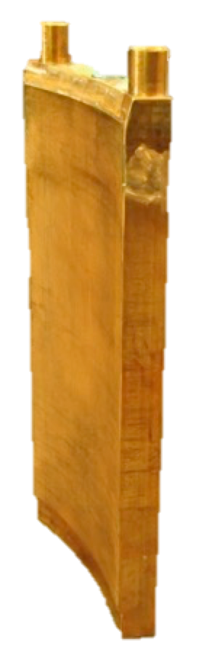
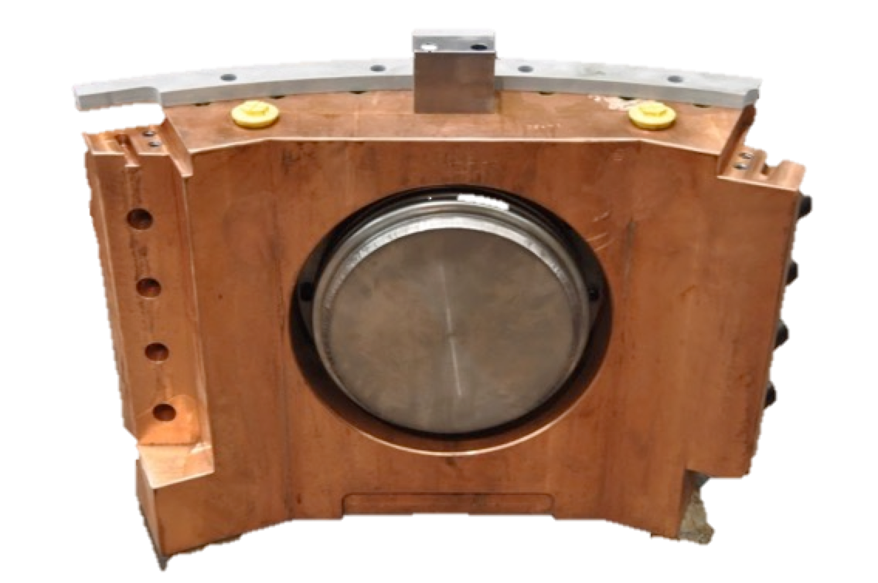
IFAPA – International Ferroalloys Conference 2018
COMETVA Solutions:
Tailor made design with medium solution:
- Example of weight for 1 400 mm electrode diameter:
610 Kg
450 Kg
Confidential

Slide 20
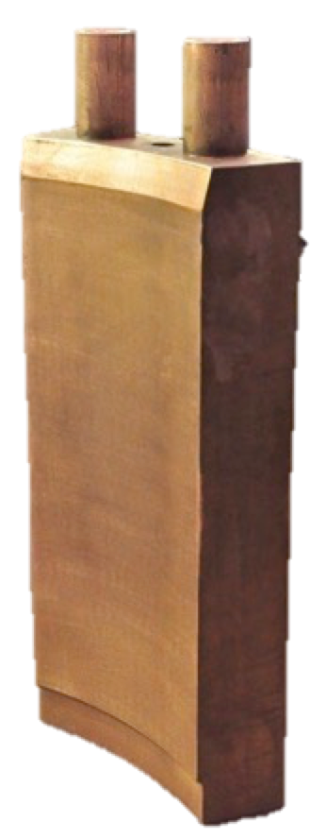
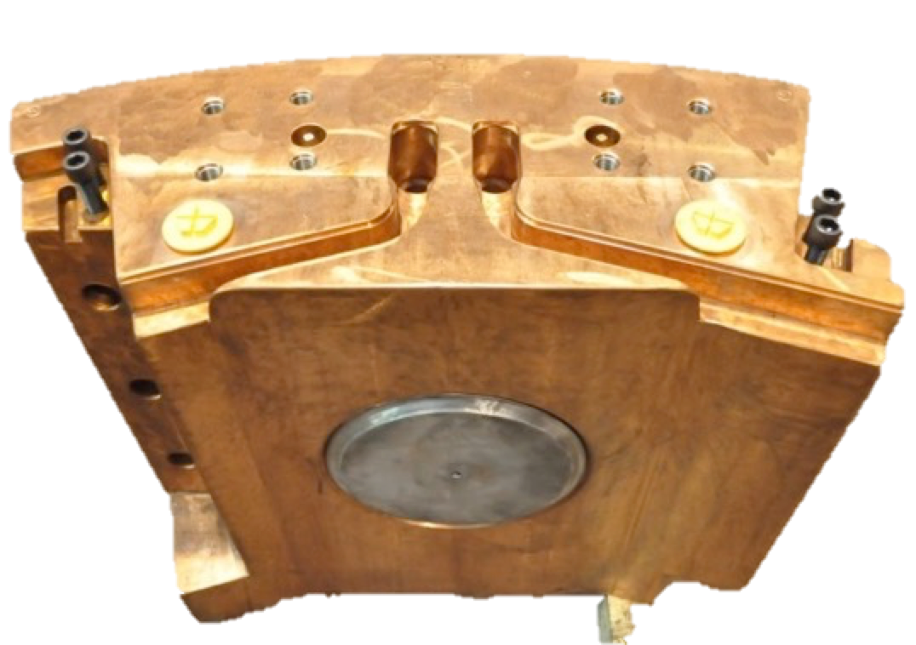
IFAPA – International Ferroalloys Conference 2018
COMETVA Solutions:
Tailor made design with heavy solution:
- Example of weight for 1 400 mm electrode diameter:
800 Kg
650 Kg
Confidential

Slide 21
IFAPA – International Ferroalloys Conference 2018
COMETVA Solutions:
Cooling line patented in India, main benefit for users:
- Safer, no plug at the bottom part, no risk of explosion
- Nice cooling distribution and so nice electrical distribution on
the electrode
- Less water quantity for same efficiency, to respect process
constraints as baking zone level
Confidential

Slide 22
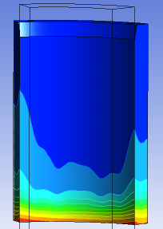
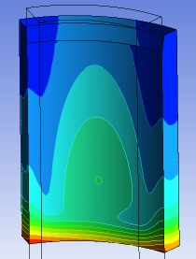
IFAPA – International Ferroalloys Conference 2018
COMETVA Solutions:
Cooling line patented in India:
Simulation made with same water flow.
Our patent needs less water quantity
Traditional U shape cooling line example
Patented cooling line example
Confidential

Slide 23
IFAPA – International Ferroalloys Conference 2018
COMETVA Solutions:
Solution to make a complete analysis of copper piece in case of client claim.
Today, our laboratory means, our updated bibliography, and our network of experts, allow us :
    - to bring customers explanations on what happened in case of damaged parts.
- to help to supply rational data on technical troubles met.
Confidential

Slide 24
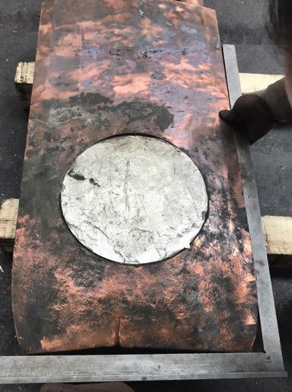
IFAPA – International Ferroalloys Conference 2018
COMETVA Solutions:
Example of complete analyses:
A client lodged a claim for an abnormal copper consumption after three years of use
We made a complete measurement of different loss
With the client approval we cut the piece at cooling line level
We proceed to chemical and granular analyses
Confidential

Slide 25
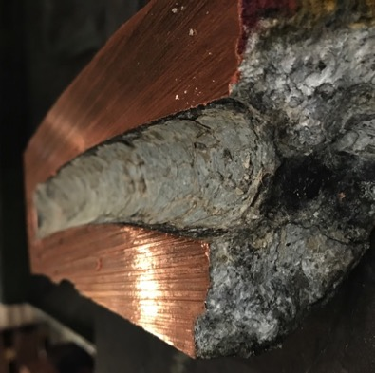
IFAPA – International Ferroalloys Conference 2018
COMETVA Solutions:
Example of complete analyses made:
We found a significant sediment layer
Results of structure and granular analyses showed a structure modification caused by a very high copper temperature related to bad water quality.
Confidential

Slide 26
IFAPA – International Ferroalloys Conference 2018
COMETVA Equipment supplied examples
Confidential

Slide 27
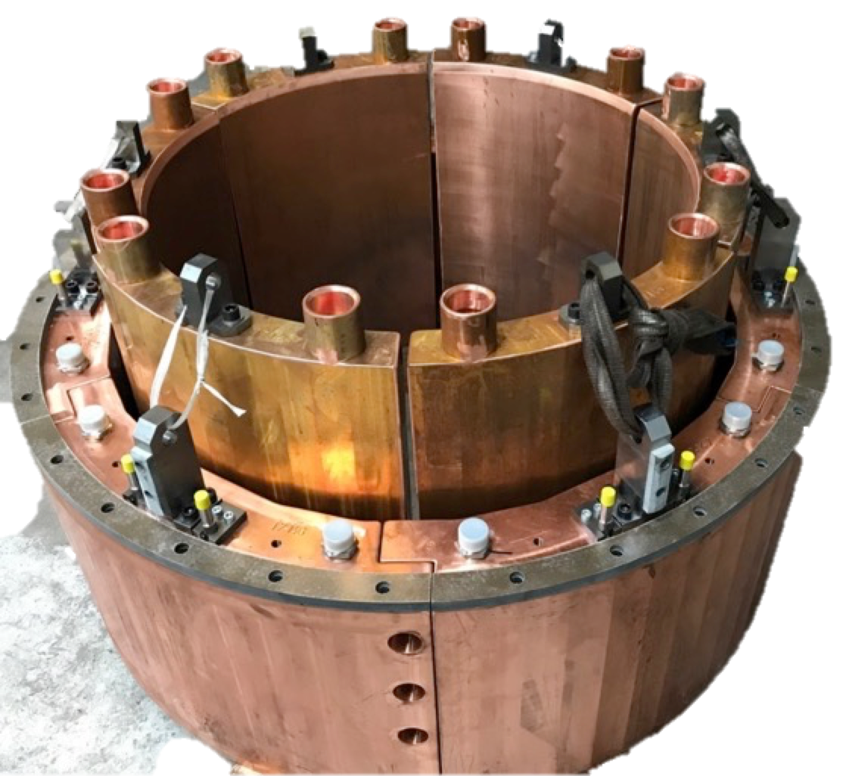
IFAPA – International Ferroalloys Conference 2018
Sarda Energy and Minerals Limited
sEL Ø 1050 mm
Confidential

Slide 28
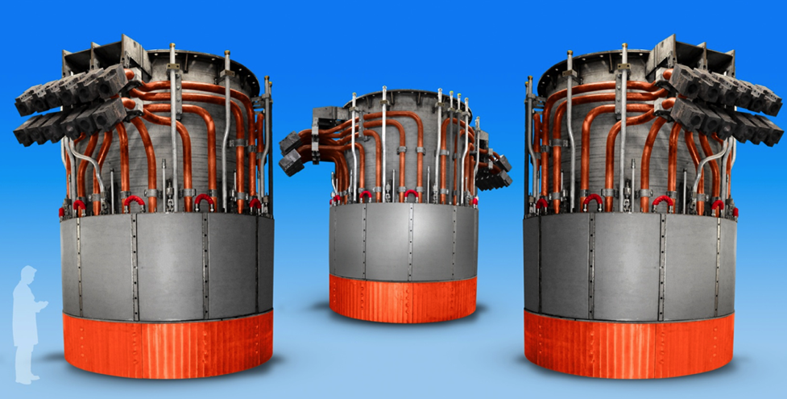
IFAPA – International Ferroalloys Conference 2018
OUTOKUMPU F3 (2011) – EL Ø 2100 mm
100 MW
Confidential

Slide 29
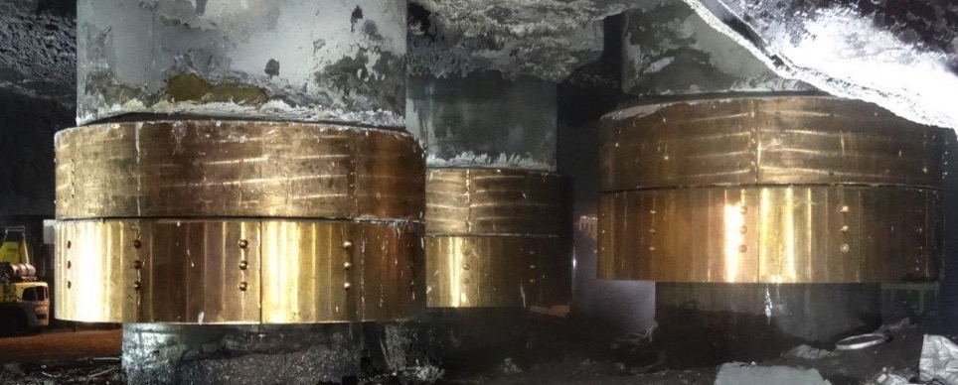
IFAPA – International Ferroalloys Conference 2018
FerroGlobe- Bridgeport – EL Ø 1550 mm
Confidential

Slide 30
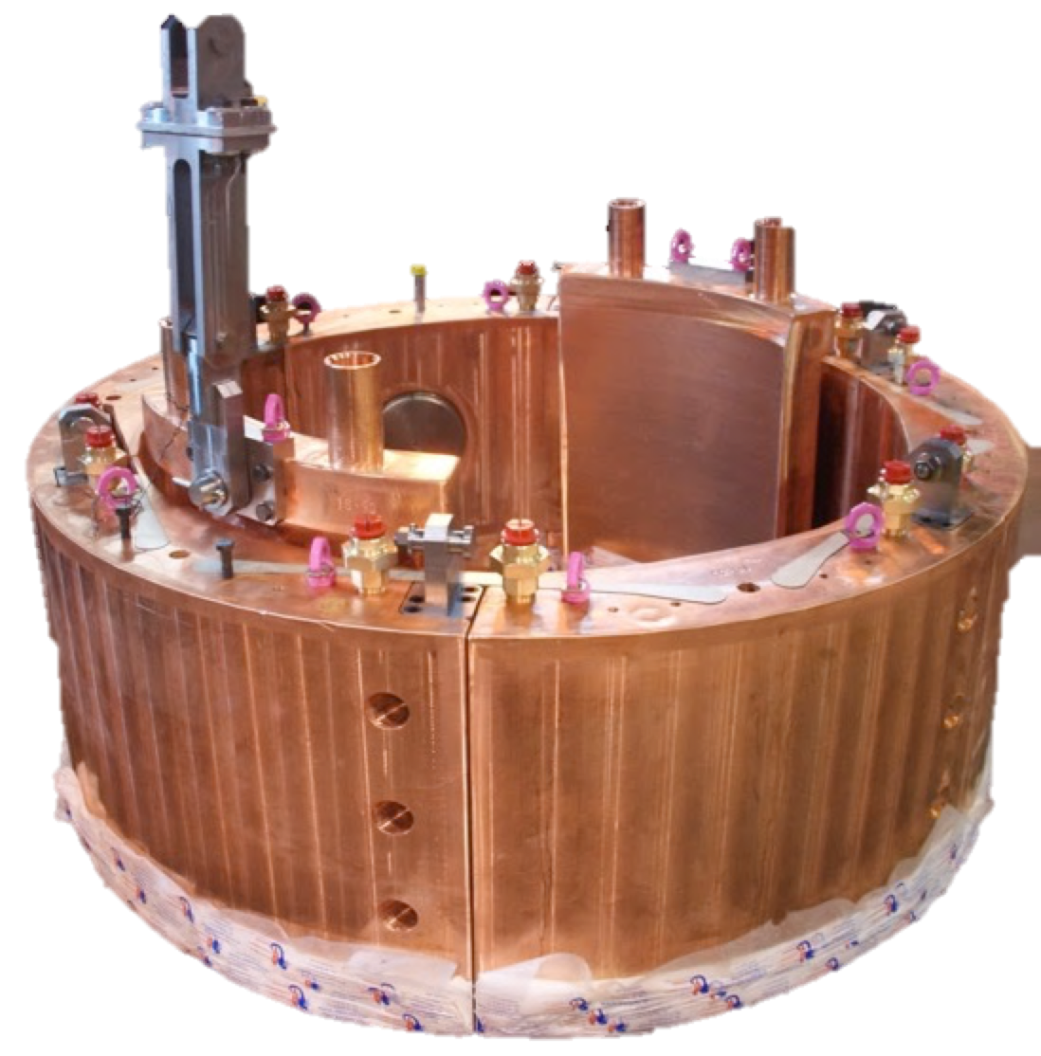
IFAPA – International Ferroalloys Conference 2018
FerroGlobe – Niagara Falls – EL Ø 1143 mm
Confidential

Slide 31
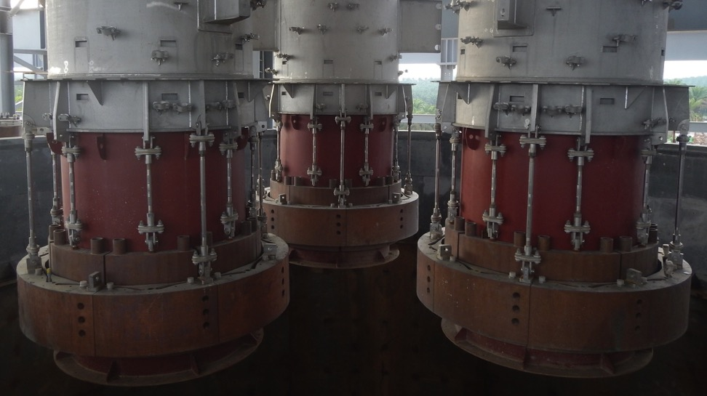
IFAPA – International Ferroalloys Conference 2018
SAKURA Ferroalloys – EL Ø 1700 mm
Confidential

Slide 32
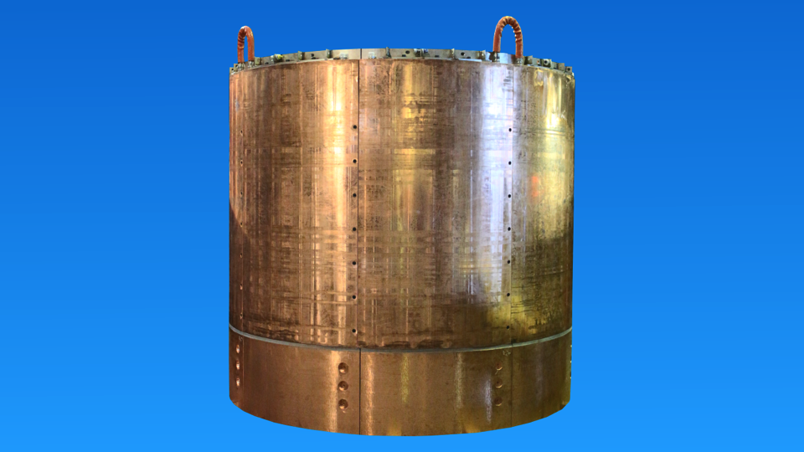
IFAPA – International Ferroalloys Conference 2018
SAKURA Ferroalloys – EL Ø 1700 mm
Confidential

Slide 33
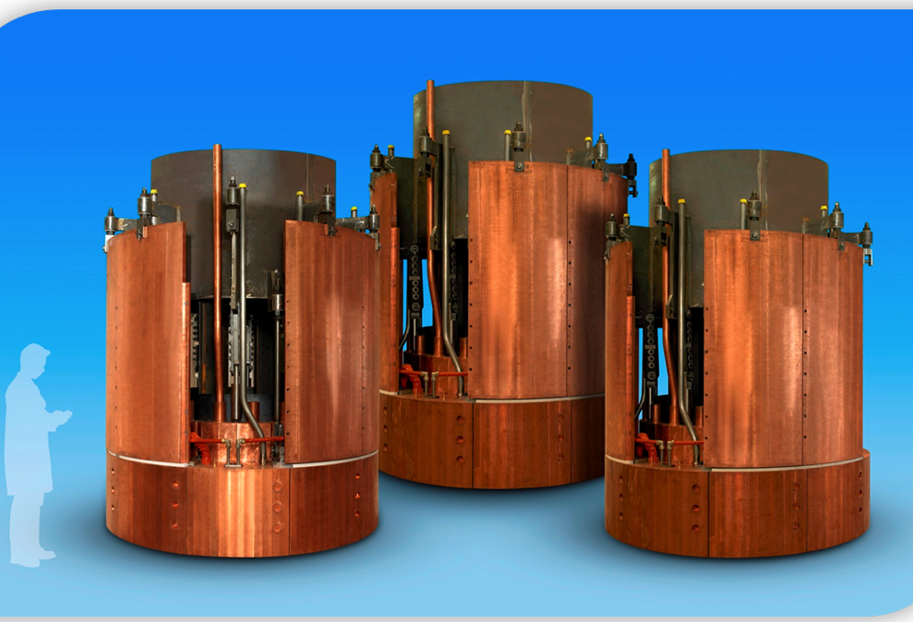
IFAPA – International Ferroalloys Conference 2018
COMPLETE ELECTRODE BOTTOM PART
CHELYABINSK (2005) – ELECTRODE Ø 1400 mm
Confidential

Slide 34
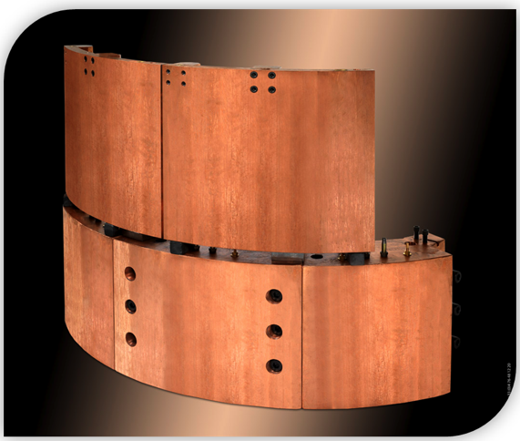
IFAPA – International Ferroalloys Conference 2018
  COFOR® Forged copper cooling shield
Forged
COFOR®
copper
Traditional cooling shield in copper.
Confidential

Slide 35
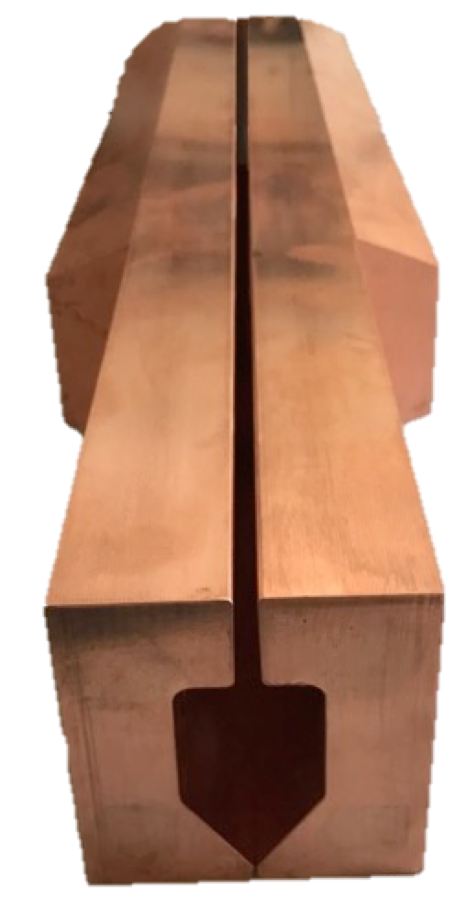
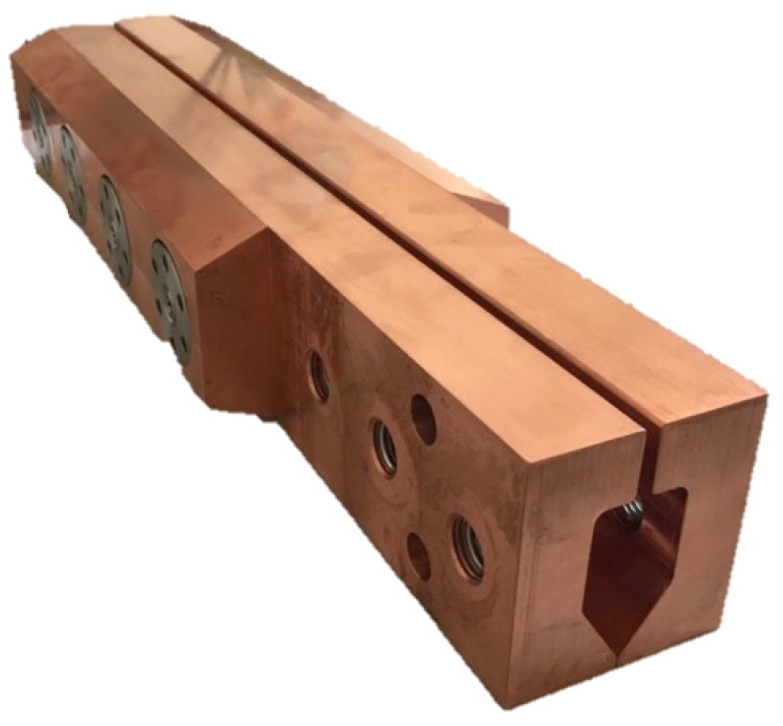
IFAPA – International Ferroalloys Conference 2018
  COFOR® modular electrode forged copper parts
Confidential

Slide 36
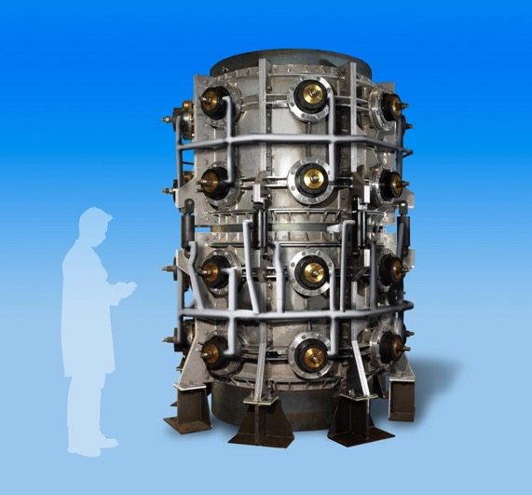
IFAPA – International Ferroalloys Conference 2018
CHELYABINSK (2005)
Confidential

Slide 37
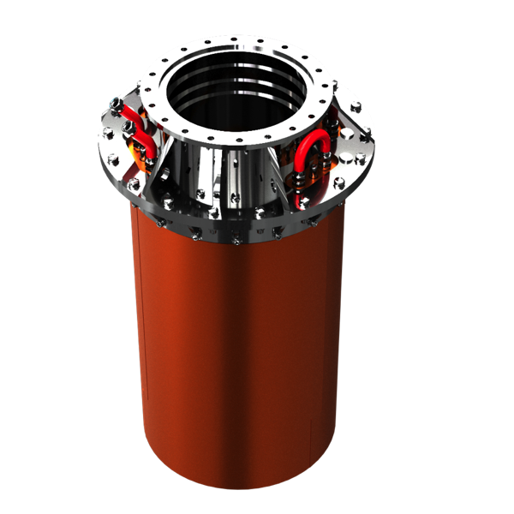
IFAPA – International Ferroalloys Conference 2018
  COFOR® Forged copper feed chute tips
Confidential

Slide 38
IFAPA – International Ferroalloys Conference 2018
Last COMETVA innovation
Complete electrode column allowing to switch between pre-backed to Soderberg or to compound electrode column without major change.
Confidential

Slide 39
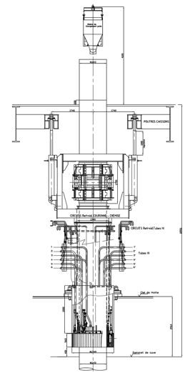
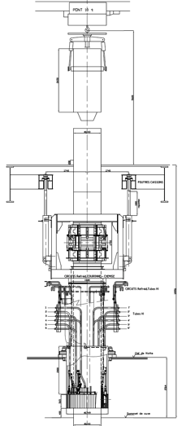
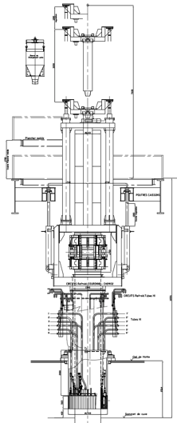
IFAPA – International Ferroalloys Conference 2018
Soderbeg electrode
Pre-backed electrode
Compound electrode
Confidential

Slide 40
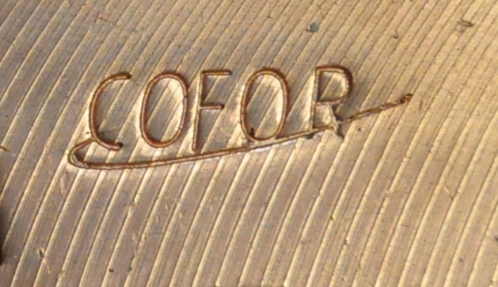
IFAPA – International Ferroalloys Conference 2018
Thank you for your attention
Our brand for Your profitability
Confidential

