Slide 1
Mn Ore - South Africa’s perspective past and future

Slide 2
Mn Ore - South Africa’s perspective past and future
Contents:
1.Mn Ore Reserves – SAfrica.
2.History of Mn ore production in SAfrica prior to 2007
3.Allocation of Mines to New Mining companies and their present performance.
4.Small & Emerging mines of High Fe Ore.
5.Transnet Allocation and Export from SAfrica.

Slide 3
Mn Ore – South Africa
The views and details mentioned are my personal based on authentic sources.
Have tried to present the details as close to reality.
However if I have missed something , its inadvertent.
My intention is to talk in details for all the Mines in SAfrica on the general scenario.

Slide 4
Mn Ore – South Africa
Mn Ore Reserves /Resource

Slide 5
Mn Ore Reserves and Resources
 | Reserves (revised 2010) in million metric tons in Mn content | Reserves (in % of total reserves) | Resources (revised 2010) in million metric tons in Mn content | Resources (in % of total reserves) | Typical head grades of Mn ore (in %Mn)
South Africa | 200 | 29% | 4,185 | 78% | 30-48%
Ukraine | 138 | 20% | 513 | 10% | 30-35%
Brazil | 117 | 17% | 51 | 1% | 37-51%
Australia | 90 | 13% | 130 | 2% | 37-53%
India | 55 | 8% | 150 | 3% | 10-54%
China | 41 | 6% | 80 | 1% | 20-30%
Gabon | 21 | 3% | 141 | 3% | 45-53%
Ghana | 28 | 4% |  |  | 32-34%
Kazakhstan |  |  | 63 | 1% | 20-30%
Mexico |  |  | 9 | 0.2% | 36-37%
Russia |  |  | 28 | 0.5%
Others |  |  | 40 | 1%
Total | 690 | 100% | 5,400 | 100%
Years of consumption* | 38 |  | 296

Slide 6
Mn ore reserves – S. Africa

Slide 7
Mn ore resources – S. Africa

Slide 8
Reserve
Resources are defined as concentrations in the earth's crust that are currently or potentially recoverable.
Resources can be measured, indicated or inferred from geological evidence, and by extrapolating values found in drill samples.
The reserve base consists of measured and indicated resources that meet criteria of grade, thickness, quality and depth required by current mining and recovery practice.
This category includes resources that are currently economic, marginally economic and sub-economic.
Reserves are the part of the reserve base that is currently economically extractable and recoverable.

Slide 9
Manganese – South Africa
South Africa’s manganese resources are by far the largest in the world, accounting for some 78% of total estimates.
Its share of reserves is 29%, and the country is the world's leading producer of manganese in terms of contained metal.
Reserves are concentrated in Northern Cape province, where deposits occur in a zone extending 150km northwards from south of Postmasburg to Wessels and Black Rock north of Hotazel.
The northern Kalahari Manganese Field (KMF), a sedimentary marine deposit, is the main source of metallurgical-grade ore.
The southern (Postmasburg) field is a secondary enrichment deposit but reserves of high-grade ore are largely depleted and output consists predominantly of ferruginous manganese ore. The companies operating in the KMF possess very large reserves of manganese.

Slide 10
Manganese – Other Countries
Ukraine has the world's second largest reserves of manganese at 138Mt (20%), with 513Mt Mn of resources (10% of the world total). Almost all Ukraine's reserves are in two sedimentary deposits: the Nikopol group in the Dnepropetrovsk oblast (33%) and the Bolshe-Tokmakskoe deposit in the Zaporozhye oblast (67%).
In Brazil, deposits exploited by Vale (Azul, Urucum and Morro da Mina) had reserves of 26Mt Mn at the end of 2010 (source: Roskill).
Australia possesses some of the world's largest reserves of manganese, mainly in the Northern Territory and Western Australia. Gemco (South32 and Anglo American) operates the Alyangula mine on Groote Eylandt, an island in the Gulf of Carpentaria (Northern Territory). The ore body is a relatively flat lateritised sedimentary deposit, 3-4m thick bed covering 150km2. The manganese ore minerals are cryptomelane and pyrolusite. The Bootu Creek deposit owned by OMH is located 130km north of Tennant Creek in the Northern Territory (source: Roskill).

Slide 11
Manganese – Other Countries
Most of the resources in India grade 35% Mn or less, and 40% are located in Orissa, 21% in Karnataka and 16% in Madhya Pradesh (source: Roskill).
China's manganese reserves are concentrated in the provinces of Guangxi (33%), Hunan (25%), Guizhou (12%) and Chongqing (9%) (source: Roskill).
In Gabon, the Lower Proterozoic Moanda deposit has been exploited since 1962. The Moanda ore is high-grade, containing 45-52% Mn (source: Roskill).

Slide 12
Mn Ore – South Africa
History of Mn ore production in S Africa prior to 2007

Slide 13
History
Around 78% of the world’s Manganese Resources which has been identified is located in South Africa.
Of these reserves, around 90% is located in the Kalahari Manganese Fields based in the Northern Cape Province of the country .
In spite of this, due to the lack of infrastructure and mining capacity, South Africa has historically ranked 2nd in the world as manganese exporter.
Manganese mining and production occurred at a steady growth rate of 1.6% per year on average from mid-1990’s to 2003.

Slide 14
History
Due to the lack of capacity, the country largely missed out on the commodity boom which occurred between 2001 and 2007, on the back of the rapid growth of the Chinese steel industry at the time.
With the Global Economic Recession which hit late in 2008 South Africa’s manganese producers were hit very hard and the country’s production declined by 33% in 2009, year on year.
The industry has since recovered though, and in 2010 production increased by 51% to around 7.2 million tons.

Slide 15
The Historic Duopoly
For Many years, the South African Manganese industry consisted of 2 major producers, Assmang and Samancor (owned 60% by BHP Billiton).

Slide 16
Samancor – S32
Operations:
Wessels Underground Mine commissioned in 1973.
Mamatwan Opencast Mine commissioned in 1964.
Current contribution to South Africa’s Export is at around 3.0– 3.2 Million tonnes.
 |  | Lump | Fines
Mn content | % | 44 | 45
Moisture | % | 3 | 6.5
P | % | 0.04 | 0.03
SiO2 | % | 3 | 3.3
CaO | % | 6.2 | 5.7
Fe | % | 12.5 | 12.6
Al2O3 | % | 0.5 | 0.4
LOI | % | 2 | 15
 |  | Lump | Fines
Mn content | % | 37.5 | 36
Moisture | % | 3 | 6.5
P | % | 0.02 | 0.03
SiO2 | % | 4.5 | 4.6
CaO | % | 3.1 | 14.2
Fe | % | 5.0 | 5.0
Al2O3 | % | 0.2 | 0.2
LOI | % | 15 | 15

Slide 17
Assmang
Operations:
Black Rock, acquired in 1940.
Gloria Underground Mine (Production commenced 1978).
Nchwaning Underground Mine (Established first shaft in 1972).
Current contribution to South Africa’s Export is at around 3.3 – 3.5 Million tonnes.
 |  | Lump | Fines
Mn content | % | 42/44 | 42/45
Moisture | % | 3 | 6.5
P | % | 0.03 | 0.03
SiO2 | % | 5.8 | 3.5
CaO | % | 6.3 | 6.7
Fe | % | 15/13 | 0.1
Al2O3 | % | 0.3 | 0.3
LOI | % | 13.3 | 13.3
 |  | Lump | Fines
Mn content | % | 37.5 | 37.5
Moisture | % | 3 | 6.5
P | % | 0.02 | 0.02
SiO2 | % | 5.8 | 6
CaO | % | 13.6 | 13.7
Fe | % | 5.5 | 5.5
Al2O3 | % | 0.2 | 0.2
LOI | % | 15.4 | 15.4

Slide 18
Mn Ore – South Africa
Allocation of Mines to New Mining companies and their present performance.

Slide 19
Development
Historically it was extremely difficult for new entrances into the Manganese Market due to the lack of infrastructure development.
In 2004 the Government announced the Mineral and Petroleum Resources Development Act (MPRDA), and opened the KMF for the establishment of new mining projects

Slide 20
United Manganese of Kalahari (UMK)
Prospecting commenced in 2005
Manganese resources identified on 3 Farms (Botha, Smart and Rissik)
Approximately 324 Million Tonnes of manganese resources was identified.
Current annual production is estimated at 2.0-2.2million tonnes.
 |  | Lump | Fines
Mn content | % | 36.5 | 36.5
Moisture | % | 3 | 6.5
P | % | 0.03 | 0.03
SiO2 | % | 7.7 | 7.7
CaO | % | 7.4 | 7.4
Fe | % | 6 | 6
Al2O3 | % | 0.4 | 0.4
LOI | % | 18 | 18

Slide 21
Tshipi e Ntle Manganese Mining
Mining operations are at the company’s Borwa property, with approximately 163 million tonnes in manganese reserves.
Annual production of about 2.8 – 3.2 million tonnes.
A second farm, Bokone, is being developed.
 |  | Lump | Fines
Mn content | % | 36.5 | 35
Moisture | % | 1.8 | 1.8
P | % | 0.04 | 0.04
SiO2 | % | 5.5 | 5.5
CaO | % | 15.5 | 15.5
Fe | % | 6 | 6
Al2O3 | % | 0.3 | 0.3
LOI | % | 17 | 17

Slide 22
Kudumane Manganese Resources
Entered the industry in 2012.
Currently producing at the opencast operation on the York farm, with production operations at the company’s second property, Hotazel farm, expected to come online later in 2018.
Annual production of 1.8 million tons, expected to increase to 2 million tons over the next few years.
Underground operations scheduled to commence in about 10 to 15 years
A combination of underground and opencast mining is expected to yield 30 years of production.

Slide 23
Kudumane Manganese Resources
 |  | Lump | Fines
Mn content | % | 36.5 | 34.5
Moisture | % | 3 | 6.5
P | % | 0.03 | 0.03
SiO2 | % | 5.5 | 5.5
CaO | % | 15.5 | 15.5
Fe | % | 5.0 | 6.0
Al2O3 | % | 0.4 | 0.4
LOI | % | 14 | 14

Slide 24
Kalagadi Manganese
Established 2001 with prospecting license granted in 2005 (Gama, Olivepan and Umtu farms)
Approximately 102 Million tons of Manganese resources were identified.
Ultimately the operation is planned to produce 3 Million tonnes per annum of Manganese ore, which would be sintered at the company’s on-site sintering beneficiation plant into 2.4 Million tonnes of higher grade sinter manganese. Presently they are doing 0.5mln tonnes.
 |  | Lump | Fines | Sinter
Mn content | % | 38.6 | 37.5 | 47.0
Moisture | % | 3.0 | 6.5 | 0.0
P | % | 0.02 | 0.03 | 0.02
SiO2 | % | 4.5 | 4.6 | 6.2
CaO | % | 3.1 | 14.2 | 14.5
Fe | % | 4.7 | 4.8 | 5.5
Al₂O₃ | % | 0.2 | 0.2 | 0.6
LOI | % | 15.0 | 15.0 | 0.0

Slide 25
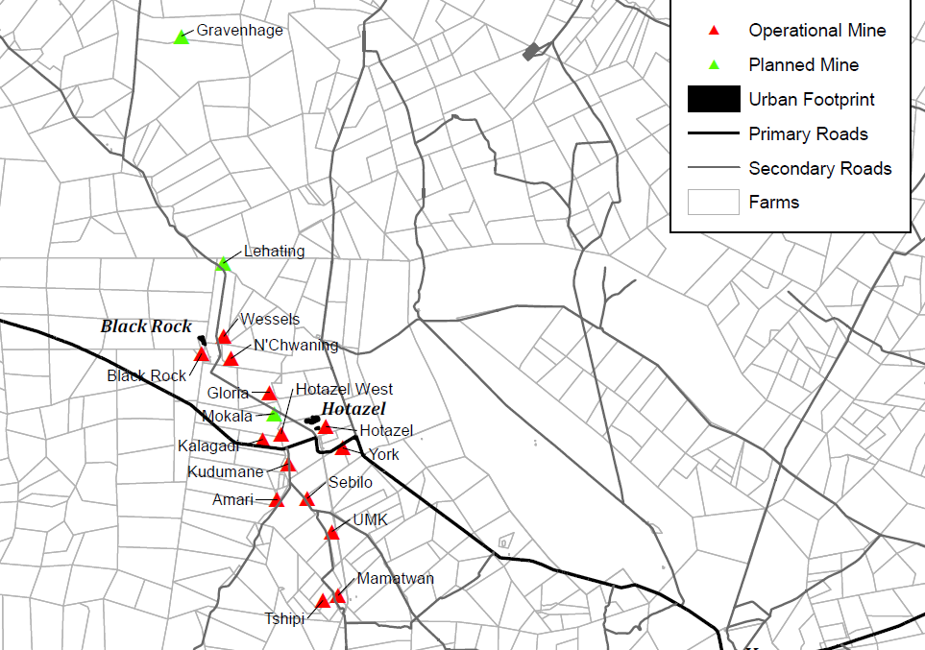
S. Africa – Location of Mn Ore Mines

Slide 26
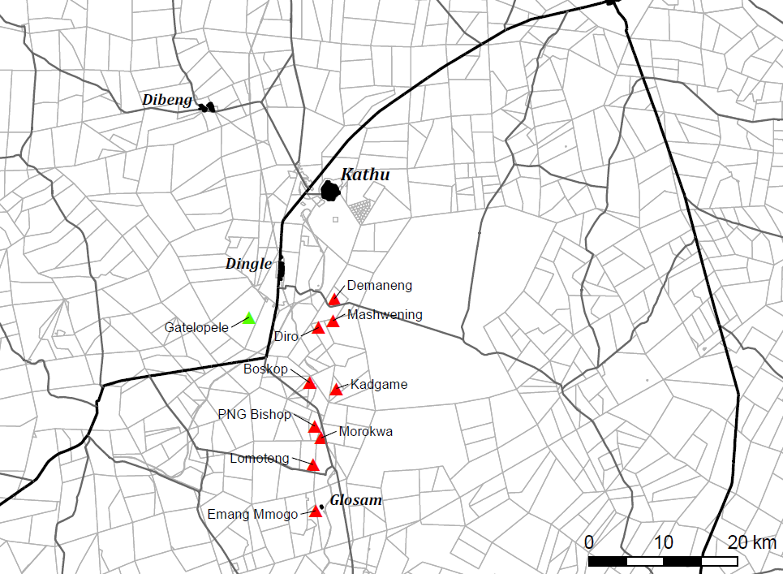
S. Africa – Location of Mn Ore Mines

Slide 27
Rough Cost Breakdown for S. A. Mines

Slide 28
Mn Ore – South Africa
Mines of High Fe Mn Ore

Slide 29
Other Smaller Emerging mining operations
Other Notable companies with ongoing operations currently producing include Sebilo Mining in the KMF area, as well as Emang Manganese Project, Lindino Mining, PMG, all based in the Postmansburg Manganese Field.
Combined, these operations contribute approximately 1.6 – 2.0 million tonnes to South Africa’s Manganese exports.
The Postmasburg Manganese Field (PMF) was discovered in 1922.
Operations stopped in the 1980’s when mining companies moved to the higher-grade KMF.
With the increased demand in Medium Grade manganese Ore, exploration and mining activities have been recommenced in recent years.

Slide 30
Mn Ore – South Africa
Transnet Allocation and Export from S Africa

Slide 31
Transnet Allocation

Slide 32
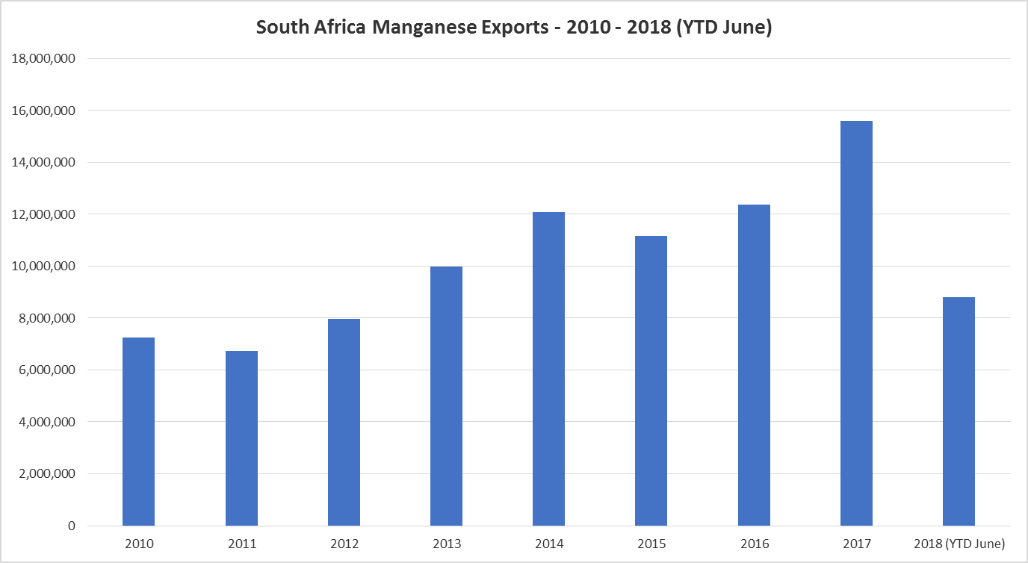
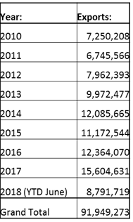
Year wise export from S. Africa

Slide 33
Mn Ore Exports - S. Africa

Slide 34
THANK YOU

